Slide 1

IoT Security Capstone
Experiment Results, Insights & Recommendations
IoT Cyber Defense Externship | 2026
Christine Khayat | Junior Cybersecurity Engineer

Slide 2
01
The Threat: Unprotected IoT Pipelines
What happens when MQTT messages travel without protection?
Eavesdrop
Inject Fake Data
Replay Attack
？An attacker intercepts data transmitted between IoT sensors and the system.
⚠ Sensitive operational information can be exposed, allowing attackers to monitor system activity.
？An attacker sends fake or modified sensor readings to the system.
⚠ False readings can mislead operators, hide real problems, or trigger incorrect decisions.
？An attacker captures legitimate messages and retransmits them later.
⚠ Old or previously valid data can be accepted as current, potentially disrupting system monitoring.
Key takeaway: Without proper security controls, IoT messages can be intercepted, manipulated, or reused, putting the hotel’s water monitoring system at risk.

Slide 3




02
Defense Architecture: Four Layers of Protection
Each layer catches what the previous one can't.
Defense 1
Defense 2
Defense 3
Defense 4
mTLS Mutual Authentication
Timestamps & Sequence Counters Replay Protection
TLS Encrypted Communication
HMAC-SHA256 Message Integrity
Encrypts data between IoT devices and the broker, preventing attackers from reading intercepted traffic.
Protects against: Eavesdropping
Requires both the broker and each device to prove their identity using trusted certificates, blocking unauthorized devices.
Protects against: Unauthorized connections and device impersonation
Verifies that messages come from a trusted source and have not been modified in transit.
Protects against: Message tampering
→
→
→
Checks message freshness and order to detect old, duplicated, or out-of-sequence messages.
Protects against:
Replay attacks
Each defense addresses a different security weakness. Encryption alone cannot prove a device is authorized or prevent a valid message from being replayed. Combining the layers provides stronger protection.

Slide 4
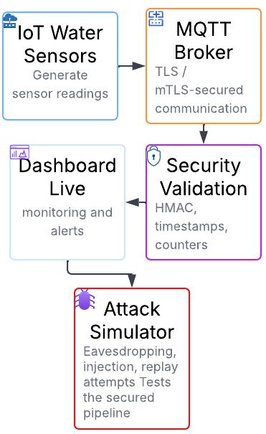
03
Experiment Setup: Three-Phase Attack Simulator
A controlled test against the live pipeline to verify every defense works.
Setup Process
Configured simulated IoT water sensors, an MQTT broker, a subscriber, and a live dashboard.
Enabled TLS and mTLS to secure communications and authenticate devices.
Implemented HMAC verification, timestamps, and sequence counters to validate incoming messages.
Ran attack simulations and monitored broker logs, subscriber responses, and dashboard alerts.
Recorded attack outcomes, message delivery, and performance measurements.

Slide 5
04
Attack Results: Every Attack Blocked
Which defense caught each attack phase — and why it works.
Attack Phase | What the Attacker Tried | Defense That Caught It | Why It Works
Phase 1: Eavesdrop | Read sensor messages sent over the network | TLS encryption | Plaintext was readable without TLS; secured traffic was protected
Phase 2: Inject | Send altered or fake sensor data | HMAC-SHA256 verification | Tampered messages were detected and blocked in the live demo
Phase 3: Replay | Resend previously captured messages | Timestamps and sequence counters | Replayed messages were rejected by the combined defenses
✔ Result: 0 attacks succeeded | 100% blocked

Slide 6
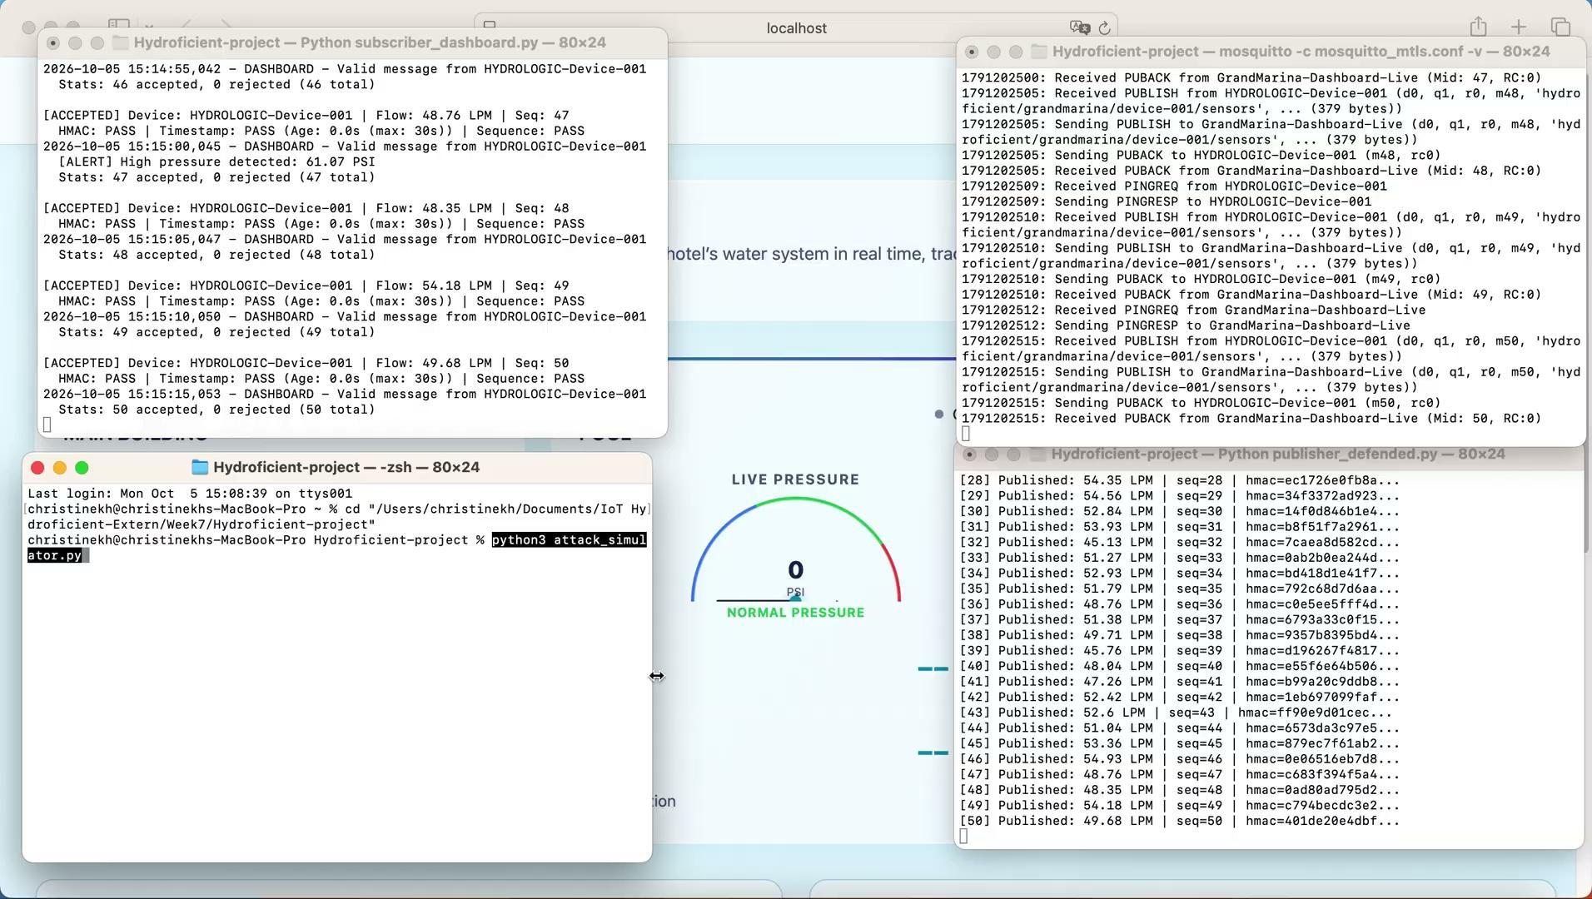
05
Dashboard: Attack Detected
Red alerts, shaking zone cards — every attack caught in real time.

Slide 7
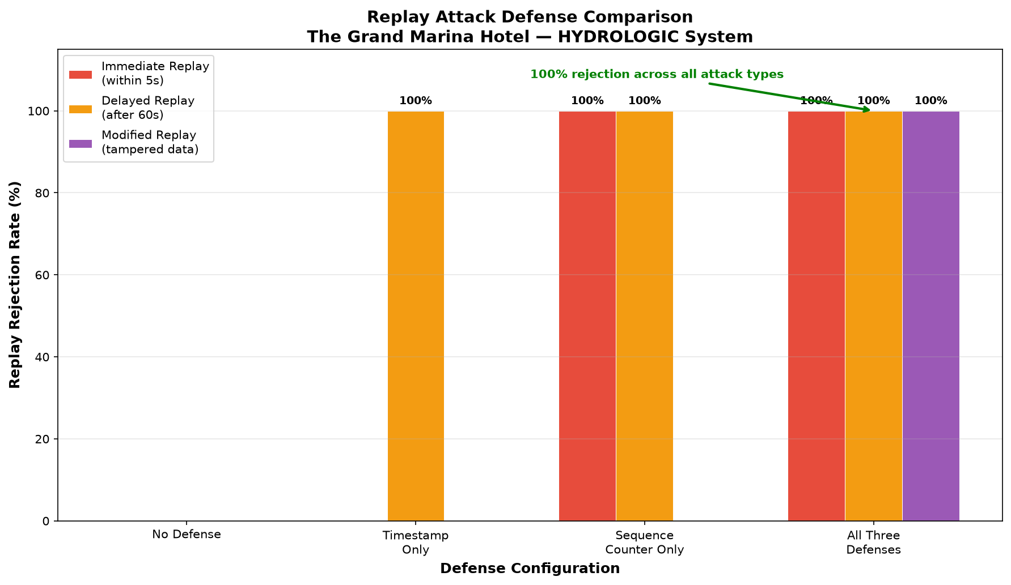
Security Analysis Chart
Bonus
Turn your experiment data into a visual argument.

Slide 8
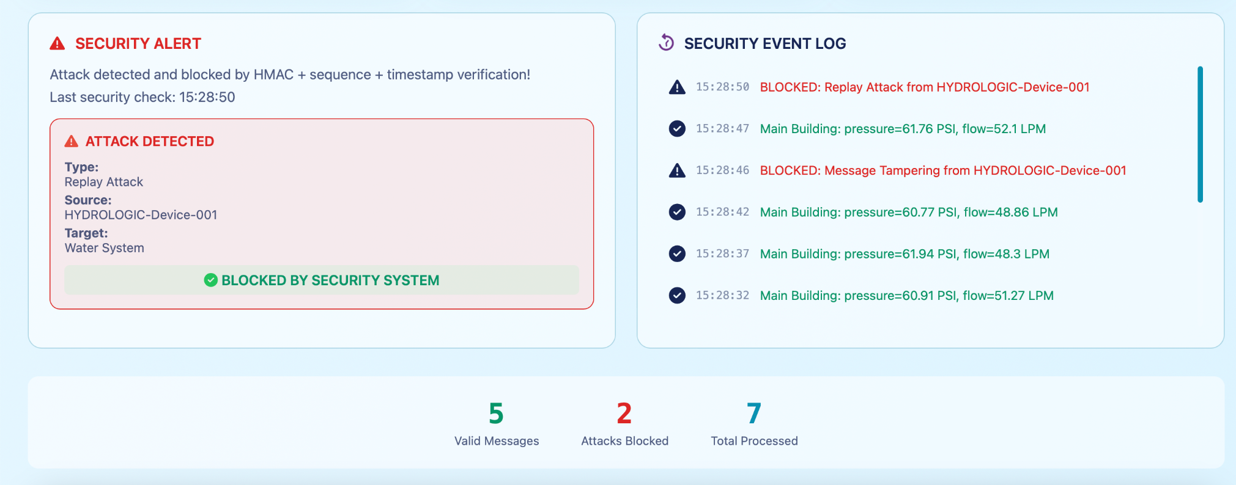
06
Stats: Attacks Blocked
The numbers tell the story — every attack rejected, every valid message accepted.
The dashboard displays security events as they occur. During the live attack demonstration, message tampering was detected and blocked by the validation system, with the event reflected in the monitoring interface.

Slide 9
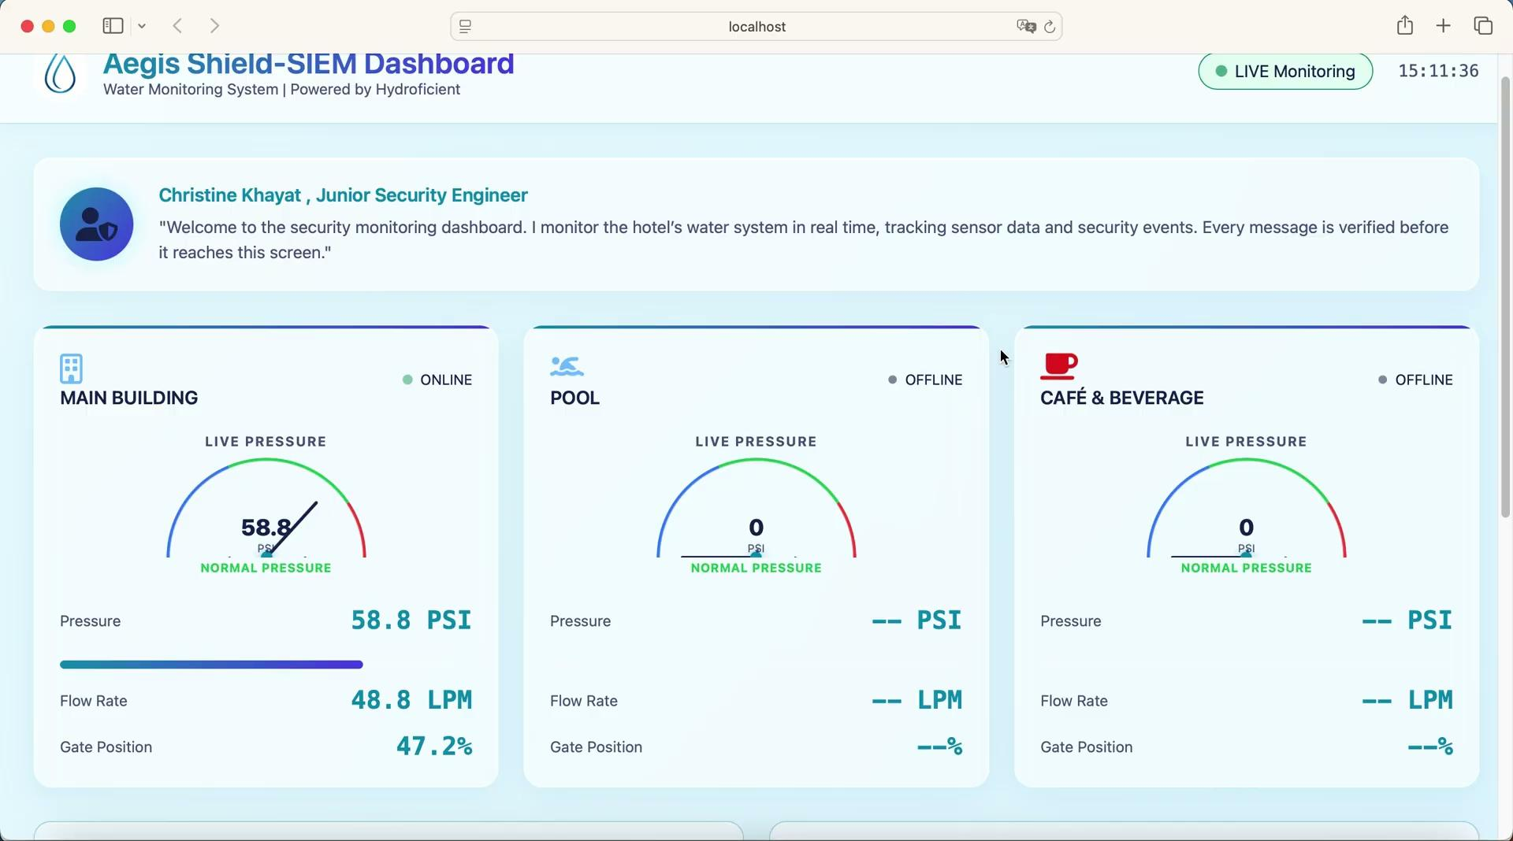
07
Custom Dashboard: Making It Mine
Personalized branding, AI-generated color theme, custom alert rules.

Slide 10
08
AI-Powered Anomaly Detection
Teaching the dashboard to catch what rules can’t — using machine learning.
Green
Orange
Red
Normal
AI Flagged
Blocked
Sensor readings pass security checks and are classified as normal by the AI model.
Messages pass rule-based checks but are flagged by AI for unusual sensor behavior.
Invalid or malicious messages are rejected by HMAC, timestamp, or sequence validation before AI scoring.
Model Used: Isolation Forest (contamination = 0.03) | Precision: 1.000 | Recall: 0.640 | F1: 0.780
What does your AI model catch that rules miss?
Isolation Forest identifies unusual combinations of pressure, flow rate, and valve position—even when messages have valid authentication, fresh timestamps, and new sequence numbers.

Slide 11
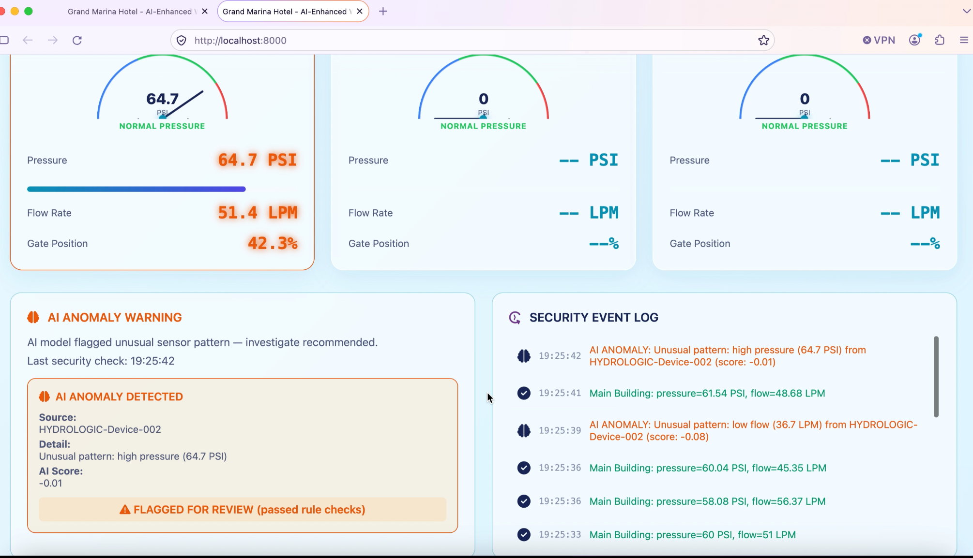
09
AI Dashboard: All Three Layers Working
Rules and AI working together — green, orange, and red in real time.

Slide 12
10
Key Insights
What this experiment revealed about IoT security.
1
No single defense is enough
mTLS stops outsiders but not compromised insiders. HMAC stops forgeries but not replays. You need all layers working together. Encryption, authentication, message integrity, and replay protection address different threats. A layered approach provides stronger security than relying on one control.
2
Security must be tested, not assumed.
Simulating attacks helped identify vulnerabilities and verify whether the implemented defenses actually worked.
3
Small performance costs can deliver meaningful security benefits.
The TLS benchmark showed approximately 0.23% average latency overhead, while mTLS added approximately 3.8% connection-time overhead in the measured tests.
4
Real-time visibility improves security response.
The dashboard made it easier to observe sensor activity, identify rejected messages, and demonstrate attack detection as events occurred.

Slide 13
11
Recommendations for Grand Marina
What should happen next to secure the IoT infrastructure at scale.
1
Deploy secure communication across all IoT devices.
Use TLS and mTLS for all sensor-to-broker connections, ensuring that devices and the broker authenticate each other.
2
Establish certificate lifecycle management.
Maintain a device certificate inventory, rotate certificates before expiry, and promptly revoke credentials for stolen or compromised devices.
3
Implement continuous monitoring and incident response.
Monitor authentication failures, rejected messages, unusual sensor readings, and suspected attacks. Establish clear procedures for investigating and responding to incidents.
4
Conduct regular security assessments.
Repeat penetration tests, replay simulations, and performance benchmarks after major system changes. Validate that defenses remain effective before expanding deployment.

Slide 14
12
Securing Every Message. Protecting Every Device.
The project progressed from identifying vulnerabilities in an IoT water monitoring system to implementing and testing a layered security pipeline.
1
Identified risks involving eavesdropping, data tampering, unauthorized access, and replay attacks.
2
Implemented TLS, mTLS, HMAC, timestamps, and sequence counters.
3
Tested security controls through simulated attacks and performance experiments.
4
Developed a real-time dashboard to visualize sensor activity and security events.
Final takeaway
A secure IoT system requires more than encrypted communication. It also needs trusted devices, verified messages, replay protection, continuous monitoring, and regular testing.

Slide 15

Questions?

